Slide 1
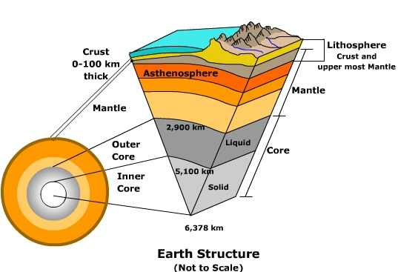
Layers of the Earth Information

Slide 3
Have you ever…
wanted to dig a hole all the way through the center of the Earth to China? Maybe you have a pen pal over there or something... Maybe you just wanted to be the first one to do it.
Turns out that as soon as you dug a hole about 5 miles deep, you would be burnt to a crisp by all the heat! No one has even been beyond the first layer of the Earth. Guess you're going to have to stick to being pen pals... or buy a plane ticket!

Slide 4
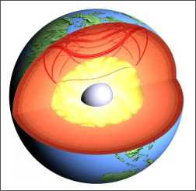
So how do we know??
If scientists have never studied any materials from a depth below 7 miles, then how is it that we know what is in the center of the Earth? How can we know what the core of the Earth is made of, if we have never seen it?
The answer is actually quite simple. While it is true that we can not study the Earth’s core using visible light, we can study it using other senses. The most important thing we use to sense the Earth’s core are seismic waves. Seismic waves are waves of energy caused either by earthquakes, or by massive manmade explosions.

Slide 5
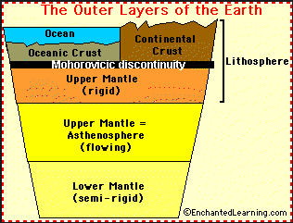
Temperature:
200-500 Celsius
Thickness (km):
Oceanic 5-10 km
Continental 30-40 km
State of Matter:
Solid
Elements:
Oxygen (O) and Silicon (Si) *Makes up 1% of Earth’s Volume

Slide 6
So…Where does the Lithosphere and Asthenosphere fit in??

Slide 7
Another way to look at it….
Mantle

Slide 8
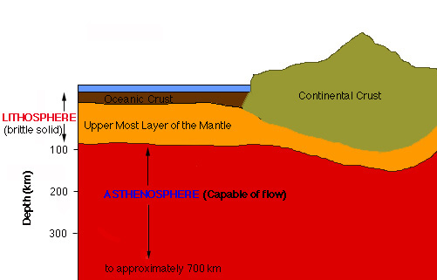
Temperature:
400 Celsius
Thickness (km):
60-100 km
State of Matter:
Brittle solid, rock like material
Elements:
Oxygen (O) and Silicon (Si)
Includes the Crust and the Upper Mantle
Litho= rock Sphere= layer
“Rock Layer”

Slide 9
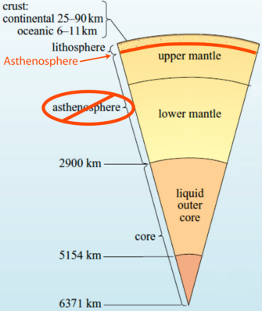
Temperature:
300-500 Celsius
Thickness (km):
180km
State of Matter:
Solid that flows like liquid,
Semi-solid or (Plastic) Plasticity
*think silly putty*
Elements:
Iron (Fe) and Magnesium (Mg)
*This is where convection currents occur!*

Slide 10
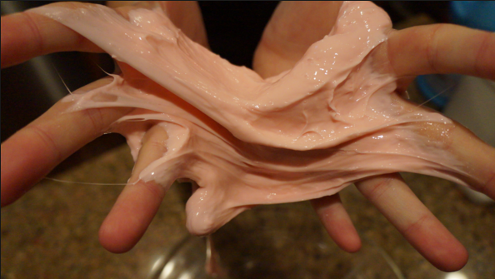
Plasticity? What is that?
Material in the asthenosphere exist in a solid state yet having the ability to flow without being a liquid.
Think….

Slide 11
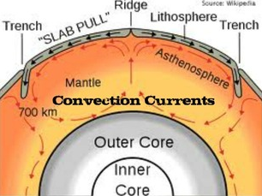
Convection Currents
Convection Currents occur in the Mantle and Asthenosphere
Convection currents make the mantle move.
The lower mantle heats up and rises and cools down then gets pushed down because it is heavier. The currents keeps on going round and round. Convection currents occur because of density of a fluid is related to its temperature. Hot rocks lower in the mantle are less dense than their cooler counterparts below. The hot rock rises and the cooler rock sinks due to gravity.

Slide 12
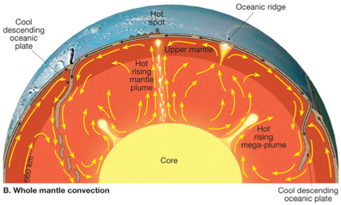
Temperature:
2,800-3,200 Celsius
Thickness (km):
2,900 km
State of Matter:
Semi-Solid
Elements:
Iron (Fe) and Magnesium (Mg)
Makes up 80-84% of Earth’s volume!

Slide 13
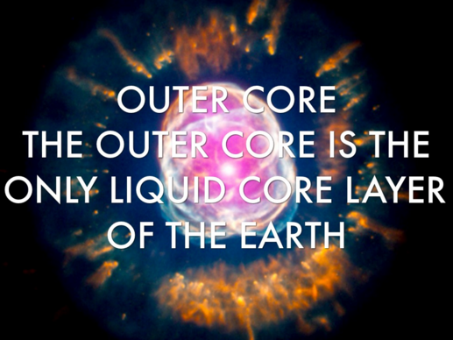
Temperature:
4,000-5,000 Celsius
Thickness (km):
2,200 – 2,250 km
State of Matter:
Liquid
Elements:
Iron (Fe) and Nickel (Ni)

Slide 15
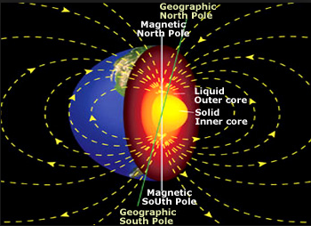
So that Magnetic Field you hear about…
The Outer Core is actually responsible for that! The magnetic field is created by the convection of hot liquid metal within the outer core.

Slide 16
More on the Magnetic Field…
The dynamo effect is a geophysical theory that explains the origin of the Earth's main magnetic field in terms of a self-exciting (or self-sustaining) dynamo.
In this dynamo mechanism, fluid motion in the Earth's outer core moves conducting material (liquid iron) across an already existing, weak magnetic field and generates an electric current. (Heat from radioactive decay in the core is thought to induce the convective motion.) The electric current, in turn, produces a magnetic field that also interacts with the fluid motion to create a secondary magnetic field. Together, the two fields are stronger than the original and lie essentially along the axis of the Earth's rotation.

Slide 17
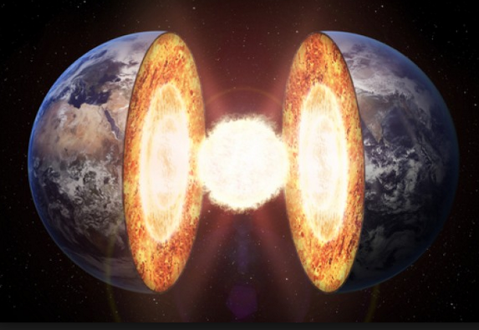
Temperature:
6,000 Celsius
Thickness (km):
1,200 km
State of Matter:
Solid
Elements:
Mostly Iron (Fe)
The Inner and Outer Core together make up 15% of Earth’s Volume

Slide 18
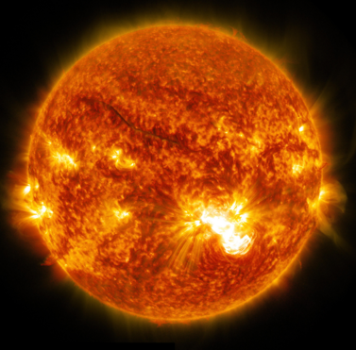
6,000 Degrees Celsius…man, that’s hot!!
The Inner Core is as hot as the surface of the sun!!!

Slide 19
So if the Outer Core is Liquid, why is the Inner Core Solid???

Slide 20
The Inner Core is growing!?!?
As the entire Earth slowly cools, the inner core grows by about a millimeter every year. The inner core grows as bits of the liquid outer core solidify or crystallize.
The growth of the inner core is not uniform. It occurs in lumps and bunches, and is influenced by activity in the mantle.

Slide 21
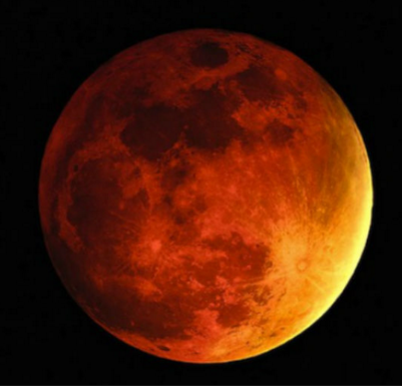
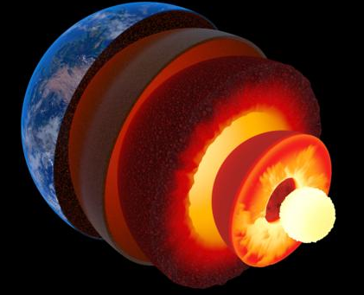
Some other interesting facts…
Did you know that the inner core and the outer core of the Earth are as big as Mars?

Slide 22
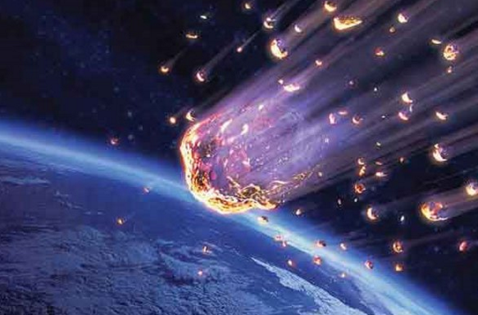
Meteorites have bits of nickel and iron in them and scientists believe that they may be pieces from other planets which have exploded!

Slide 23
So why does the information very??
You may have noticed that the temperatures vary depending on where you get your information… you may have noticed the thicknesses vary… Why? Why is there a “range” of temperatures or a “range” of thicknesses….??

