Slide 1
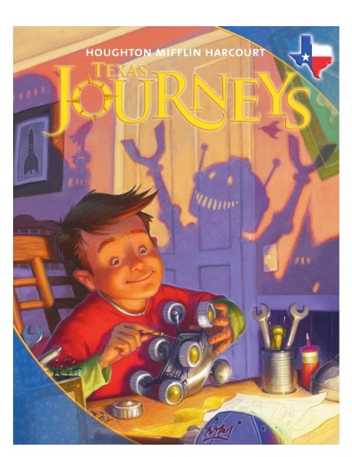
Unit 1: Lesson 4
Vocabulary
Copyright © 2011 Kelly Mott
Notes:
1

Slide 2
Part 1: Introduce Vocabulary
Copyright © 2011 Kelly Mott
Notes:
2

Slide 3
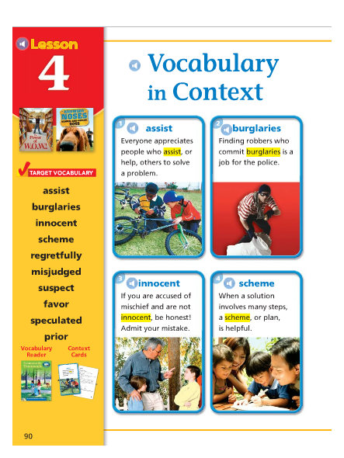
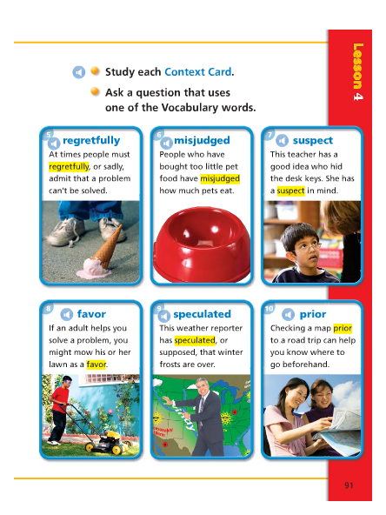
Copyright © 2011 Kelly Mott

Slide 4
assist
Copyright © 2011 Kelly Mott

Slide 5
The word assist is a verb.
Let’s pronounce it by syllables:
as-sist
Say it again, please:
assist

Slide 6
The word assist means to help.
I might assist the elderly man across the street.
The Red Cross might offer assistance to people after a disaster.

Slide 7
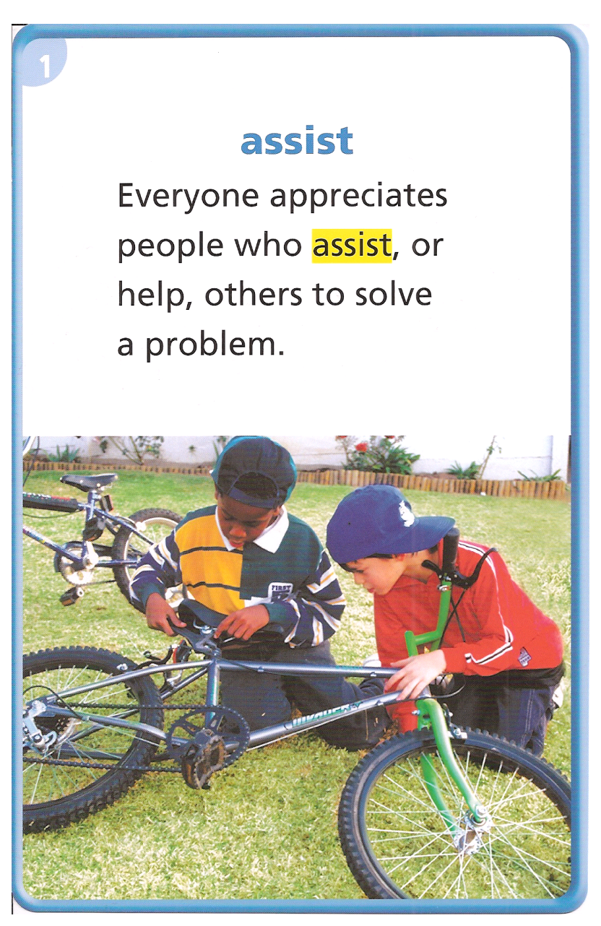
C.J. Mc Collum might assist Damian Lillard in scoring the basket.
The student finished his homework without any assistance from his parents.
The girl assisted her mother in baking cookies.
A’s tell B’s “ When have you assisted someone?”
Copyright © 2011 Kelly Mott

Slide 8
burglaries
Copyright © 2011 Kelly Mott

Slide 9
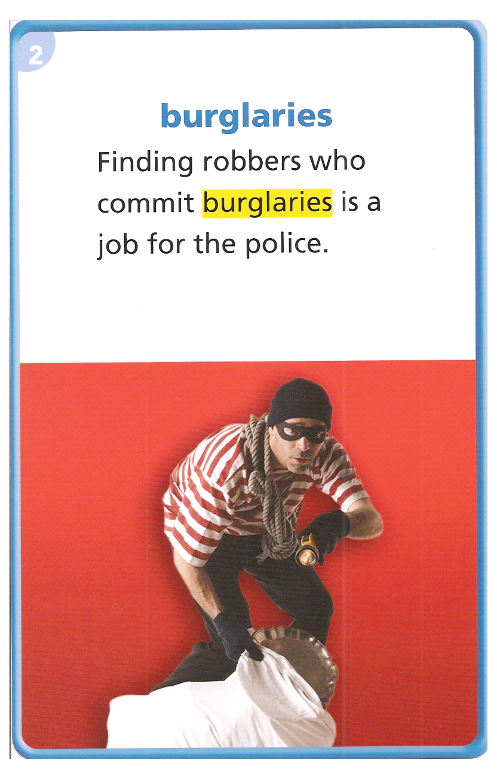
People who commit burglaries break into buildings and steal things.
The police arrested the man who committed a burglary at the mini-mart.
B’s tell A’s “What can people do to prevent burgaries?”
Copyright © 2011 Kelly Mott

Slide 10
innocent
Copyright © 2011 Kelly Mott

Slide 11
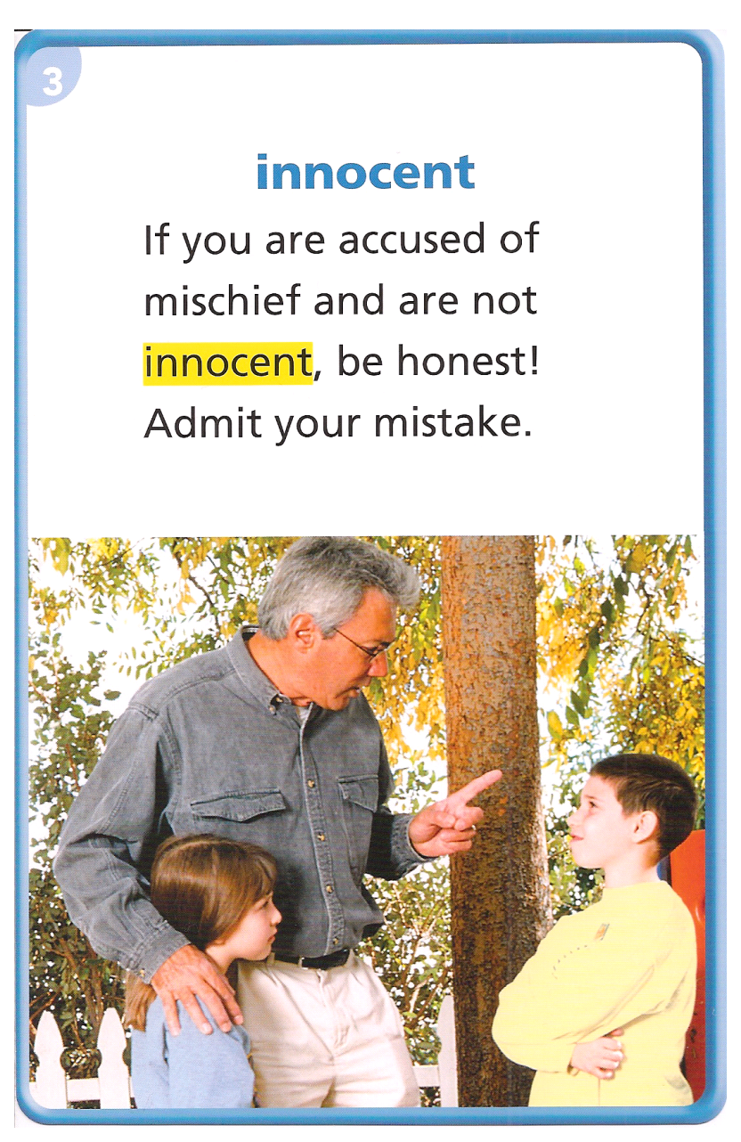
A person who is innocent has done nothing wrong.
The man on trial said he was innocent of the crime.
My dog always tries to look innocent when I catch her doing something wrong.
A’s tell B’s “ Have you ever been accused of something when you were innocent?”
Copyright © 2011 Kelly Mott

Slide 12
scheme
Copyright © 2011 Kelly Mott

Slide 13
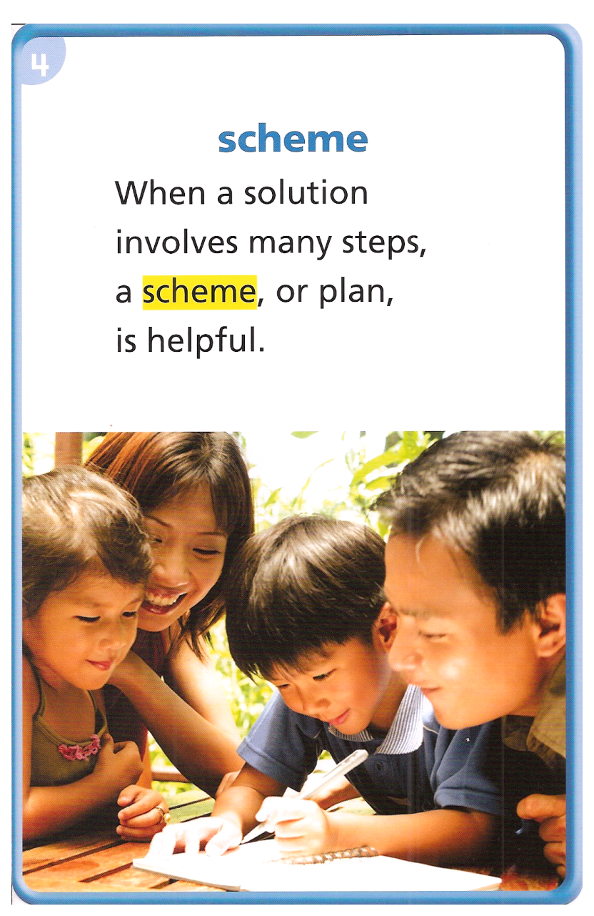
A scheme is a detailed plan to get something done.
She had a scheme for planning the surprise birthday party.
Mr. Blasquez had a scheme for how to keep children safe during an emergency.
The coach had a scheme to beat the other team.
Copyright © 2011 Kelly Mott

Slide 14
regretfully
Copyright © 2011 Kelly Mott

Slide 15
If people say something regretfully, they say it in a way that shows they are sorry.
He regretfully told his mother that he was the one that broke the vase.
‘I didn’t mean it,” she said regretfully.
B’s tell A’s “What have you said regretfully and to whom?”
Copyright © 2011 Kelly Mott

Slide 16
misjudged
Copyright © 2011 Kelly Mott

Slide 17
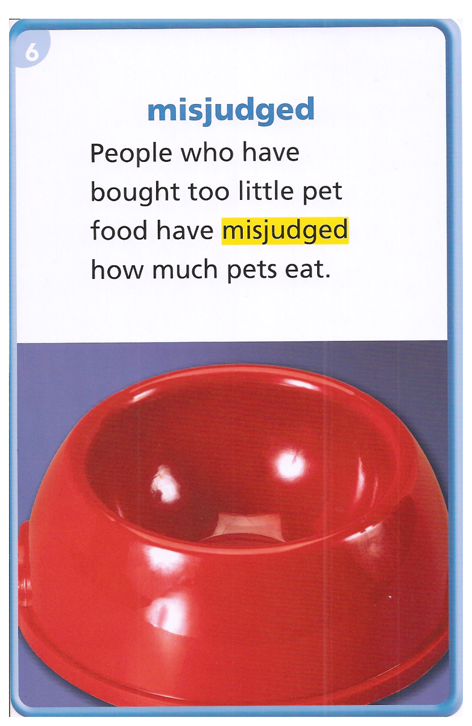
If a person has misjudged something, the person has formed an incorrect idea about it.
Sometimes we misjudge people when we first meet them.
He misjudged the distance when he tried to jump across the puddle.
Copyright © 2011 Kelly Mott

Slide 18
suspect
Copyright © 2011 Kelly Mott

Slide 19
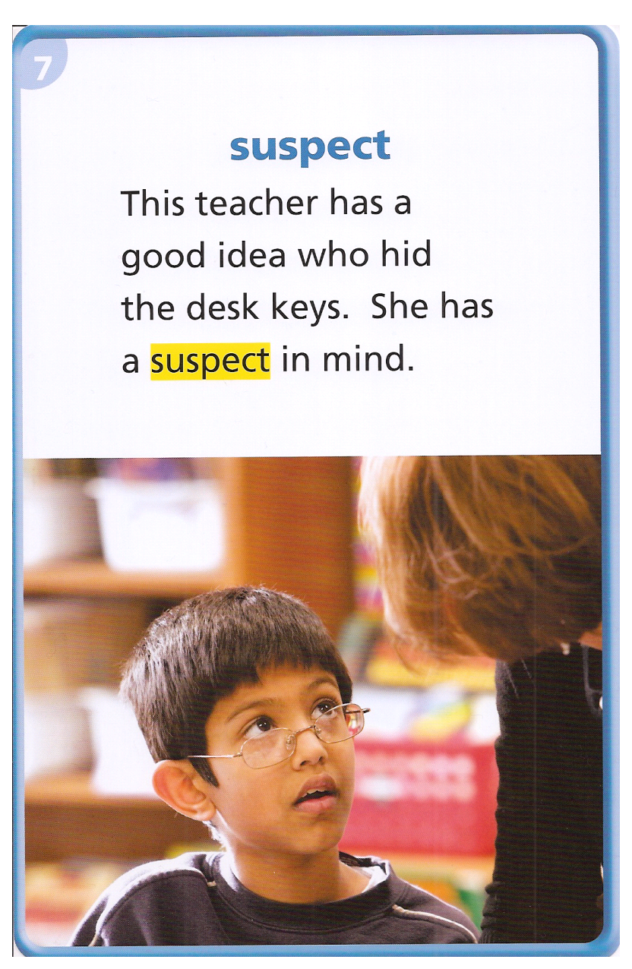
A suspect is a person who people think might be guilty of a crime.
He suspected his brother ate his candy.
The detective suspected that he committed the burglary.
I think she suspected the surprise party.
Copyright © 2011 Kelly Mott

Slide 20
favor
Copyright © 2011 Kelly Mott

Slide 21
The word favor is a noun.
Let’s pronounce it by syllables:
Fa-vor
Say it again please:
Favor

Slide 22
The word favor is an act of kindness tthat someone does, even though he or she does not have to.
You might ask your friend to do you a favor and give you a ride to practice.

Slide 23
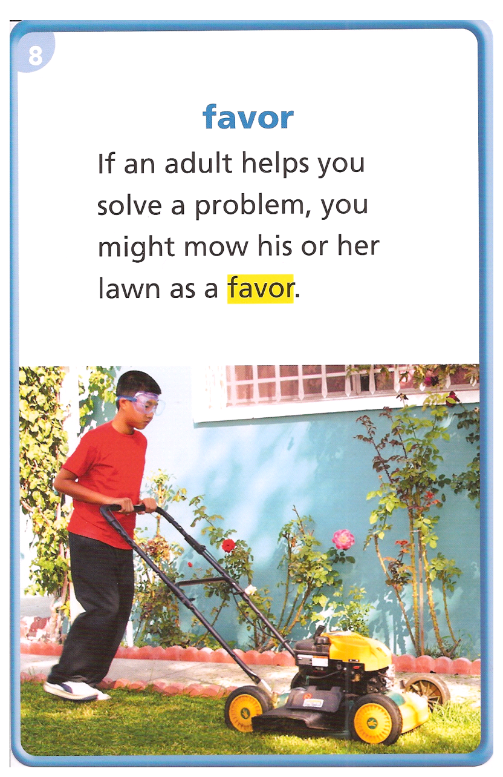
As a favor to his neighbor, he picked up their mail while they were on vacation.
He did his sister’s chores as a favor when she was sick.
A’s tell B’s “Have you ever done a favor for a friend?”
Copyright © 2011 Kelly Mott

Slide 24
speculated
Copyright © 2011 Kelly Mott

Slide 25
The word speculated is a verb.
Let’s pronounce it by syllables:
Spec-u-lat-ed
Say it again please:
Speculated

Slide 26
The word speculated means to think or guess.
The media speculated about the winner of the presidential election.

Slide 27
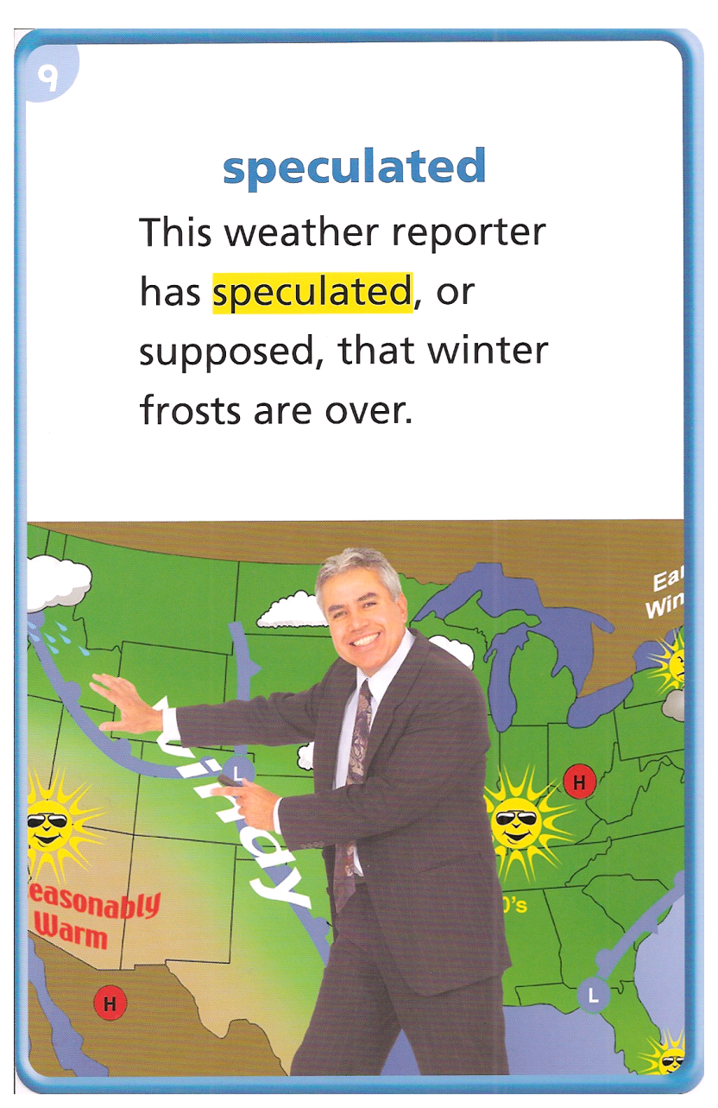
He speculated that the Seahawks would win the game.
Geologists speculated on when the volcano would erupt.
Scientists speculate about when the next big earthquake will occur.
B’s tell A’s “ Who do you speculate will win the Civil War game between the Ducks and the Beavers?”
Copyright © 2011 Kelly Mott

Slide 28
prior
Copyright © 2011 Kelly Mott

Slide 29
The word prior is an adjective.
Let’s pronounce it by syllables:
pri-or
Say it again please:
prior

Slide 30
The word prior means before.
An event that takes place prior to another event takes place before it.
Prior to turning in your work, you always put your name on it.

Slide 31
He studied very hard prior to taking the test.
He put the leash on the dog prior to taking him for a walk.
She set the table prior to cooking dinner.
Most people make a list prior to going to the grocery store.
Copyright © 2011 Kelly Mott

Slide 32
Copyright © 2011 Kelly Mott

