Slide 1
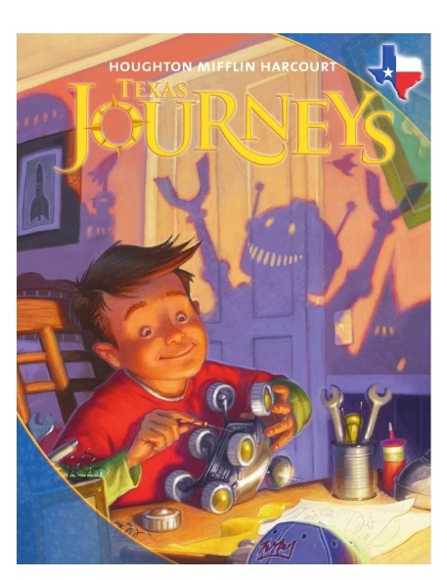
Unit 1: Lesson 5
Vocabulary
Copyright © 2011 Kelly Mott
Notes:
1

Slide 2
Part 1: Introduce Vocabulary
Copyright © 2011 Kelly Mott
Notes:
2

Slide 3
Turn your Book to pages 134-135.
Copyright © 2011 Kelly Mott

Slide 4
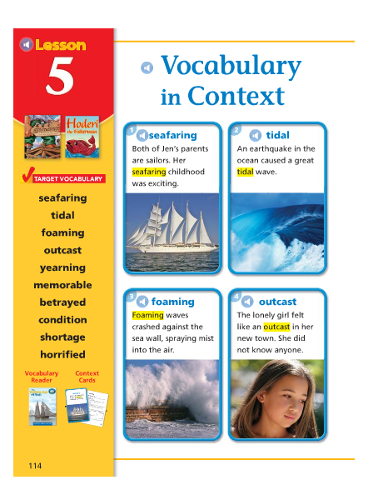
Copyright © 2011 Kelly Mott

Slide 5
seafaring
Copyright © 2011 Kelly Mott

Slide 6
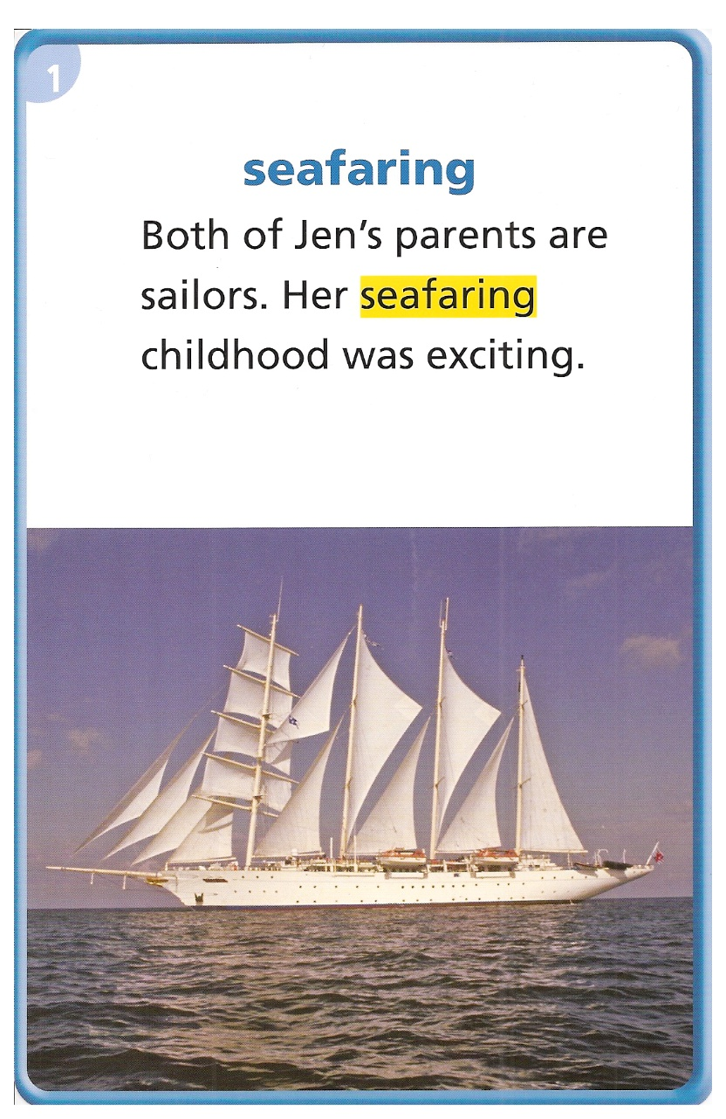
Seafaring means working or traveling at sea.
A fisherman is a seafaring man.
An pelican is a seafaring bird.
A sailor is a seafaring person.
A life quard is not a seafaring person.
Copyright © 2011 Kelly Mott

Slide 7
tidal
Copyright © 2011 Kelly Mott

Slide 8
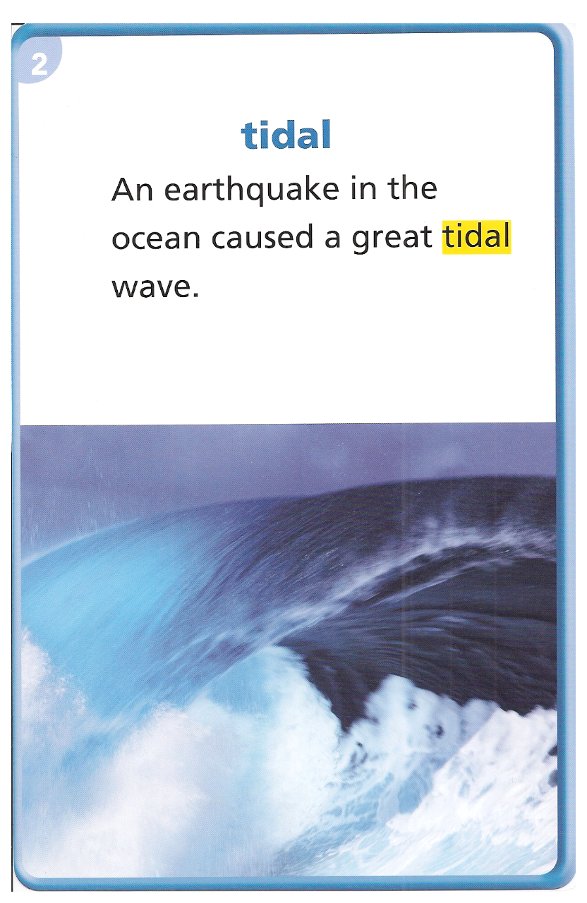
Something that is tidal is affected by the tides, or the regular rise and fall of the sea level.
Tidal currents can affect the fish and plants that live in a freshwater lake.
She was careful not to swim too far from shore, in order to avoid the dangerous tidal pull of an undertow.
Copyright © 2011 Kelly Mott

Slide 9
foaming
Copyright © 2011 Kelly Mott

Slide 10
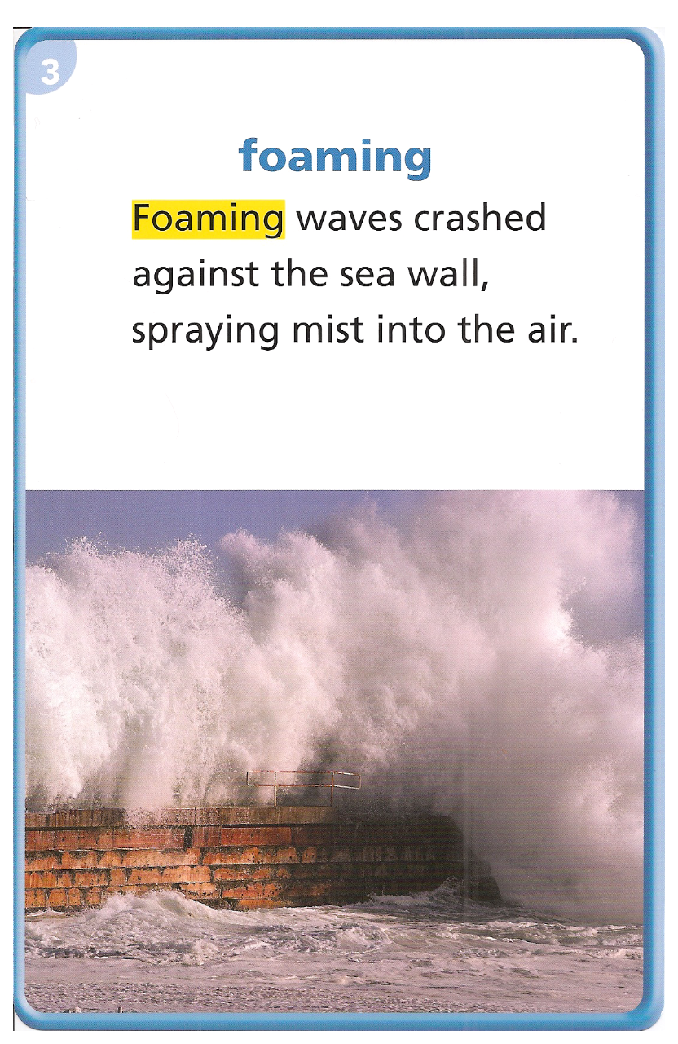
A liquid that is foaming makes a layer of foam, or small bubbles.
We have foaming hand dispensers at C.F.T.
The airport foamed the runway before the plane landed.
The foam mattress was very comfortable to sleep on.
Copyright © 2011 Kelly Mott

Slide 11
outcast
Copyright © 2011 Kelly Mott

Slide 12
Someone who is not accepted by a group may feel like an outcast.
The Duck fan felt like an outcast at the Beaver football game.
Ginny Baker felt like an outcast as the only female on the baseball team.
The Ugly Duckling felt like an outcast.
A’s tell B’s “Have you ever felt like an outcast?”
Copyright © 2011 Kelly Mott

Slide 13
yearning
Copyright © 2011 Kelly Mott

Slide 14
A yearning is a strong desire for something.
I am yearning for summer.
The girl was yearning for one of Grandma’s cookies.
The boy was yearning for pizza.
B’s tell A’s “ What do you have a yearning for?”
Copyright © 2011 Kelly Mott

Slide 15
memorable
Copyright © 2011 Kelly Mott

Slide 16
The word memorable is an adjective.
Let’s pronounce it by syllables:
Mem-o-ra-ble
Say it again please:
Memorable

Slide 17
Something that is memorable is so special that it is worth remembering.
The most memorable events in my life were the birth of my two sons.

Slide 18
Her most memorable event in her life was her wedding day.
Winning the state championship was very memorable.
Scoring the winning touchdown was very memorable.
A’s tell B’s “What is a memorable event in your life?”
Copyright © 2011 Kelly Mott

Slide 19
betrayed
Copyright © 2011 Kelly Mott

Slide 20
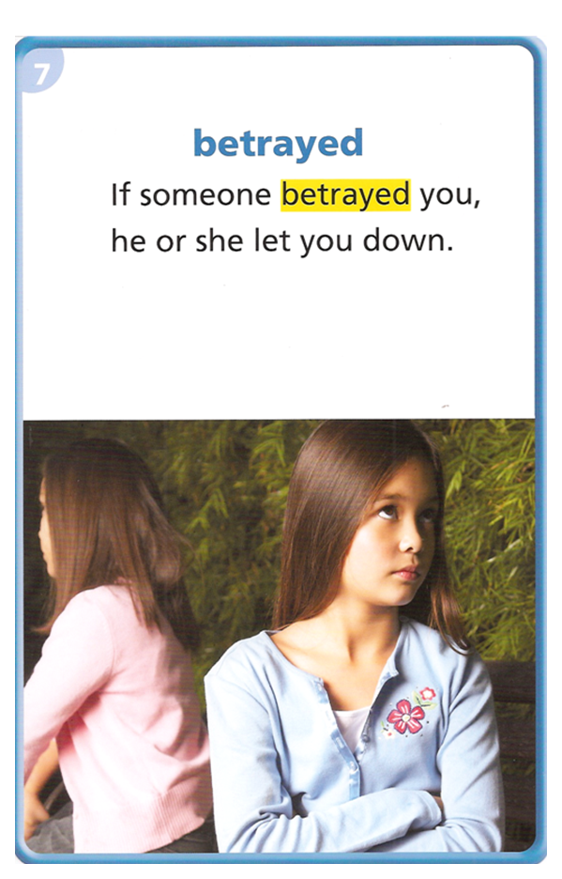
If you have betrayed someone, you have done something to disappoint or let that person down.
The girl betrayed her friend by telling her secret to someone else.
He betrayed his own people by supporting the enemy.
B’s tell A’s “Have you ever been betrayed by a friend?”
Copyright © 2011 Kelly Mott

Slide 21
condition
Copyright © 2011 Kelly Mott

Slide 22
The word condition is a noun.
Let’s pronounce it by syllables:
Con-di-tion
Say it again please:
Condition

Slide 23
The word condition is the state in which something exists.
I stay in good physical condition by getting eight hours sleep, eating healthy, and getting exercise daily.

Slide 24
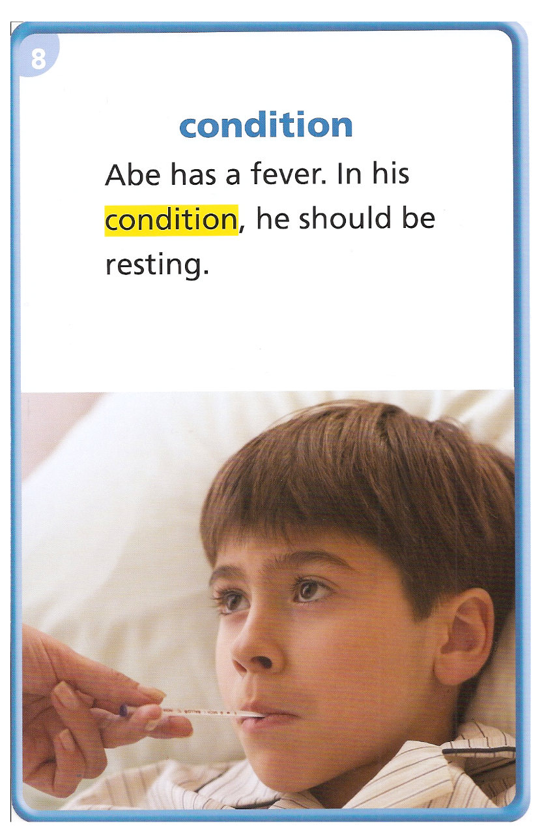
The marathon runner was in great physical condition.
The building was in poor condition and in need of repairs.
If the baseball card is in good condition it is worth more money.
The weather conditions cancelled school.
Copyright © 2011 Kelly Mott

Slide 25
shortage
Copyright © 2011 Kelly Mott

Slide 26
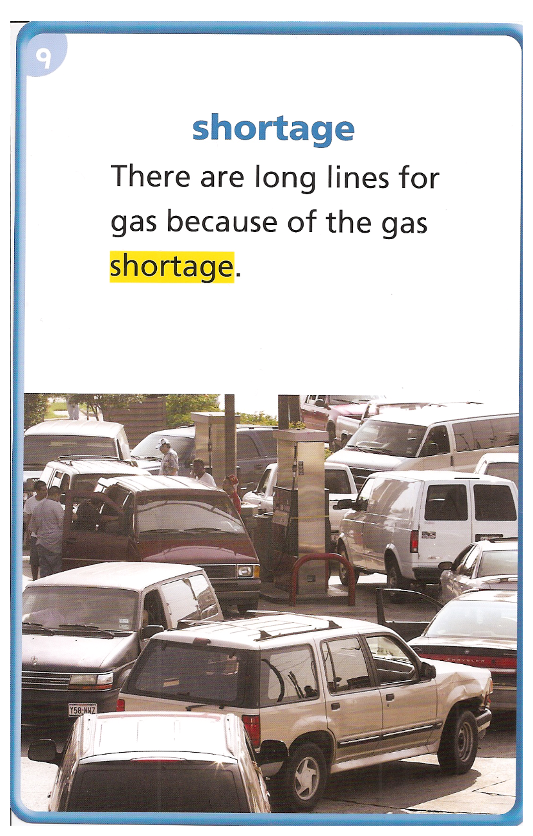
If there is not enough of something, there is a shortage of it.
If there was a shortage of food, people would go hungry.
At the beach there is no shortage of sand.
During the drought, the water shortage caused plant and crops to dry out.
Copyright © 2011 Kelly Mott

Slide 27
horrified
Copyright © 2011 Kelly Mott

Slide 28
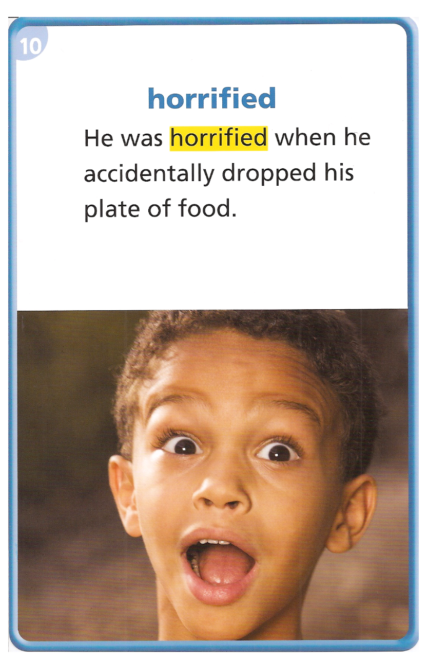
Someone who is horrified feels shock, terror, or fear because of something unpleasant.
The child was horrified when the burglar broke into his house.
They were horrified by the violence in the movie.
The mom was horrified when her favorite pair of shoes got shredded by the puppy.
Copyright © 2011 Kelly Mott

Slide 29
Copyright © 2011 Kelly Mott

